Slide 1
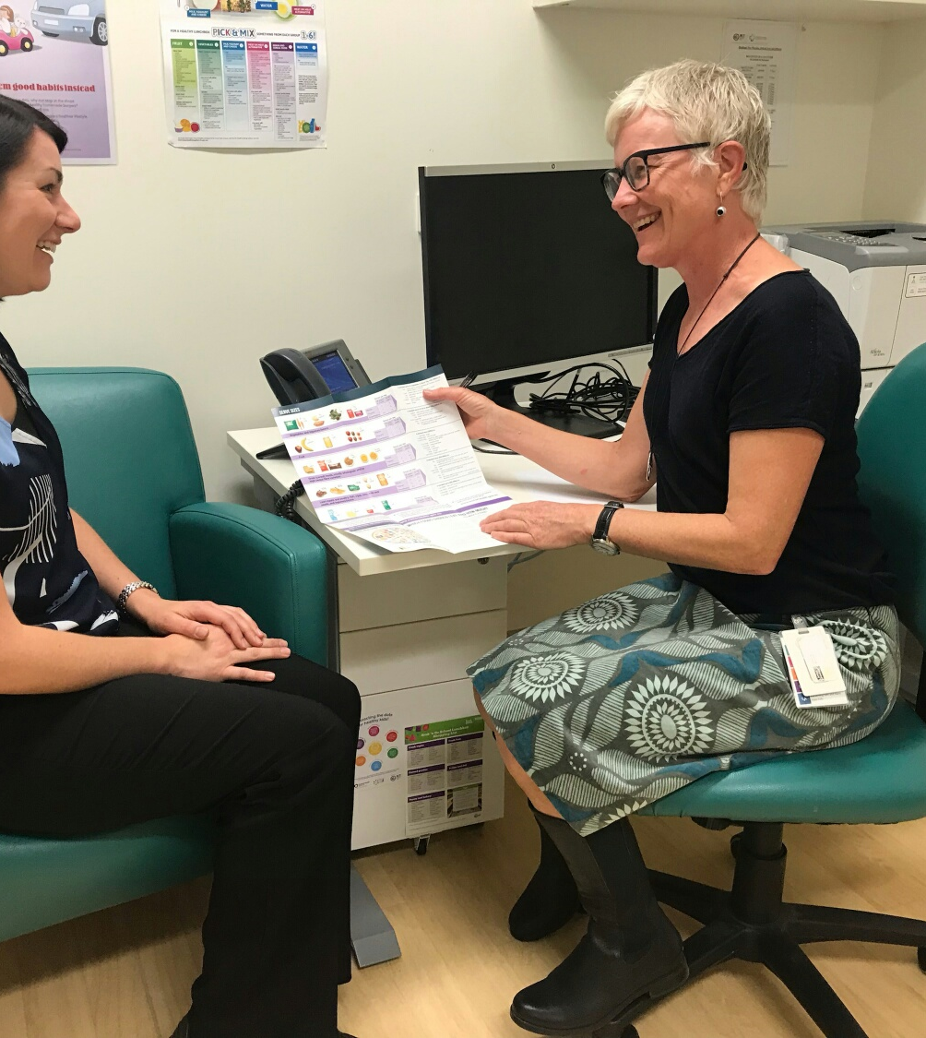
Allied Health Postgraduate Scholarship Scheme
This information is a summary taken from the detailed Postgraduate Scholarship Scheme guidelines available at:
https://www.health.act.gov.au/careers/allied-health/learning-and-professional-development/postgraduate-scholarship-scheme
Please refer to these guidelines for further information.

Slide 2
Aim
The Scheme is a workforce retention initiative that provides financial subsidy to eligible allied health professionals undertaking postgraduate programs of study that are relevant to the ACT public health system.
The Scheme aims to support ongoing allied health professional education and skill development, and enhance practice in service areas and professions, particularly those with identified workforce needs.

Slide 3
Submitting an Application
To ensure a successful application:
Ensure you are eligible to apply
Ensure your course is eligible
Complete an online application form
Provide all required supporting documentation
Identify 2 senior referees
Submit all required components by 5.00pm on second Friday in February of the academic year in which the study will be undertaken
Notes:
The purpose of today’s session is to help ensure your application is successful
We will address each point in further detail throughout the session

Slide 4
General Eligibility
Applicants for the Scheme must satisfy personal and course eligibility criteria.
Note: An application that is both eligible and ‘approved’ might not necessarily be funded.
Notes:
It is important to note that an application that is both eligible and ‘approved’ or supported by your referees, supervisor and work area might not necessarily be funded

Slide 5
Personal Eligibility
Eligible allied health discipline (refer to list on website); AND
Australian citizen or permanent resident of Australia; AND
Employed with Canberra Health Services, ACT Health Directorate and/or Calvary Public Hospital Bruce for at least 12 continuous months, either permanently or temporarily; AND
At least two years full-time equivalent work experience in your discipline since graduation; AND
Able to provide evidence of a formal offer of place in a postgraduate course; AND
Have not received a scholarship through the Scheme for a new course of study within the previous three years; AND
Able to provide evidence of current registration OR evidence of eligibility for membership of relevant professional association.
Notes:
Take a copy of the eligible AH disciplines

Slide 6
Course Eligibility
Relevant to applicant’s profession, workplace and organisation
Be of at least six month’s full-time duration
Related to clinical practice, education, management and leadership and/or research/data science
On-shore university course at AQF Level 8 and above (Graduate Certificate, Graduate Diploma, and Masters - by Coursework)
Notes:
AQF = Australian Qualifications Framework which is the national policy for regulated qualifications in Australian education and training
Chief Allied Health Office has a list of previously approved postgraduate courses -Q:\CS\Central\Allied Health Office\Allied Health Scholarships-Postgraduate\04 Previously Approved Courses.
The list however is not a guarantee that another applicant applying for a listed course will necessarily be successful - outcome mediated by total requests, available budget etc

Slide 7
Out of scope courses
Courses offered by overseas universities
Short courses (less than 6 months full-time)
Vocational qualifications
Courses that lead to an entry level allied health qualification
Courses that will result in change of discipline
Masters by Research and PhDs
Massive Open Online Courses (MOOCs)

Slide 8
Application Form and Supporting Documents
Online application form, address selection criteria
Evidence of current registration (AHPRA) or certified evidence of allied health qualification / eligibility for membership
Payroll Statement confirming:
Your name and AGS or Calvary ID number;
Commencement date with Canberra Health Services / ACT Health Directorate and/or CPHB;
Permanent employee or temporary;
if temporary provide evidence of at least 12 months continuous employment as at the Scheme closing date
Duty statement
Notes:
Application forms are now completed online. This was new in 2019 and worked well. Please contact Maria or Kate if you experience any problems with the form.
Response to selection criteria should explain the relationship between the proposed course of study and your area of allied health practice (maximum 500 words)

Slide 9
Supporting Documents
Curriculum vitae
Course outline or link
Evidence of course enrolment
Invoice for Semester 1 (where available)
Notes:
Need to communicate with the university regarding proposed course fees for year of study
If they can’t provide by closing date you will need to include indicative amount (based on last year)
All funding calculations are based on the aggregated amounts stated by applicants
Need as precise an estimate as possible

Slide 10
Referee Reports
Identify appropriate referees as soon as possible
Applications must include the names of two senior referees:
At least one must be a senior allied health professional
One must be from current line manager (may or may not be an allied health professional)
Must be HP3 classification, or equivalent, or above
Discuss application with referee to ensure they can address your claims at SC1 and SC2
Late referee reports not accepted without evidence of extenuating circumstances
Notes:
Complete your application early enough to be able to discuss your completed application with your referee so they can speak to your course / claims
Referee reports need to be able to address:
1. The applicant’s commitment to continual improvement and excellence in their area of practice;
2. How the proposed course of study will add value or benefit to the applicant’s profession, team, division and/or the broader organisation and community;
3. The applicant’s capacity to complete postgraduate level study.
Note: SC1/2 = selection criterion 1/2

Slide 11
How to Submit your Application Package
Electronic application form
Upload supporting documents
Electronic referee report form
Late applications will not be accepted without a written request seeking extension due to extenuating circumstances.

Slide 12
Assessment Process
All applications screened by Administrator;
Provisional recommendations;
Administrator and Chief Allied Health Officer assess scheme’s capacity to support provisionally recommended applicants;
Final offers are determined based on available funds.
Notes:
The following assessment process is followed:
i. The AHPGSS Administrator screens and assesses all applications against eligibility and selection criteria.
ii. Applications identified as meeting the criteria are provisionally recommended for a postgraduate scholarship and then identified to the Chief Allied Health Officer for further consideration.
iii. The Scheme Administrator and Chief Allied Health Officer assess the Scheme’s capacity to support provisionally recommended applicants. If the total funding required to support all provisional recommendations is greater than the available budget, then scholarships will be prioritised based on areas of need. Areas of need may be informed by service areas or workforce shortage reports, are subject to change, and may differ from year to year.
iv. Recommendations are made and may be referred to an Assessment Panel for final determination, noting that scholarship offers must be informed by available funding.

Slide 13
Priority
Allied health disciplines in official shortage locally and/or nationally, as evidenced by national, state and territory skill shortage information
Alignment of course of study with health priorities

Slide 14
Funding Challenges
Increase in number of applications
Significant increase in tuition fees
Scholarship budget static - adjusted by CPI
Scholarship funding has varied over past 13 years
50% through to 100%
Funding for one semester may be different to another in the same year

Slide 15
What’s included?
In-scope - Tuition fees only
Out of scope
Student Services Amenities Fees
Travel, accommodation, books

Slide 16
Other Schemes
Study Assistance - refer Training, Education and Study Assistance Procedure
Loan Scheme for Tertiary Study - refer Training, Education and Study Assistance Procedure
Notes:
Study assistance is an ACT Government scheme to support staff to acquire skills and knowledge through recognised external qualifications that will benefit the organisation and the individual. Provision of study leave and/or financial assistance is at the discretion of your approving delegate after consideration of equity and fairness in allocation of assistance, your performance plan and development needs, and work area requirements. Financial support is refunded after successful completion of unit(s). AHPGSS recipients are not eligible to apply for financial assistance through this scheme but may apply for study leave.
Loan Scheme for Tertiary Study (LSTS) assists employees with fee payment for tertiary education related to their employment. The loan provides advanced payment of course fees which must be repaid through regular payroll deduction within the semester of study.
It should be noted that:
O The Office of Professional Leadership and Education does not administer these schemes; and
O Any applicant who seeks support from these schemes should note this on their AHPGSS Application Form at Section 8.

Slide 17
Fringe Benefits Tax
FBT is payable by the employer - not the employee
FBT is applicable to HECS-HELP and FEE-HELP funded courses
Chief Allied Health Office does not have a budget for FBT and any FBT liability comes out of the Scholarship Scheme cost centre
All approved applicants are required to complete an FBT Declaration - this helps Canberra Health Services / ACT Health minimise its FBT liability
CPHB pays FBT for its staff where applicable
Notes:
The reimbursement of study expenses incurred by the employee may give rise to an employer expense payment fringe benefit.
The reimbursement of HECS-HELP and FEE-HELP attracts FBT and will be treated as an expense payment fringe benefit.

Slide 18
Scholarship Offers and Payment
Aim to inform you of outcome before the Semester 1 census date – i.e. early March in academic year
Preliminary offers sent by email - you are asked to reply and confirm if accepting scholarship offer - includes agreed funding
Once offers accepted, formal Deed of Agreement and FBT form are sent - need to be signed, dated and witnessed
Payment is by way of reimbursement at end of each supported semester - subject to documentary evidence
Notes:
You will be emailed with a request for documentary evidence:
Statement of results from the University - showing unit code and grade awarded;
Commonwealth Assistance Notice;
Payslip - confirming current employment;
Bank account details

Slide 19
Questions?
Phone: 5124 9451
Email: AlliedHealthScholarships@act.gov.au

